Slide 1
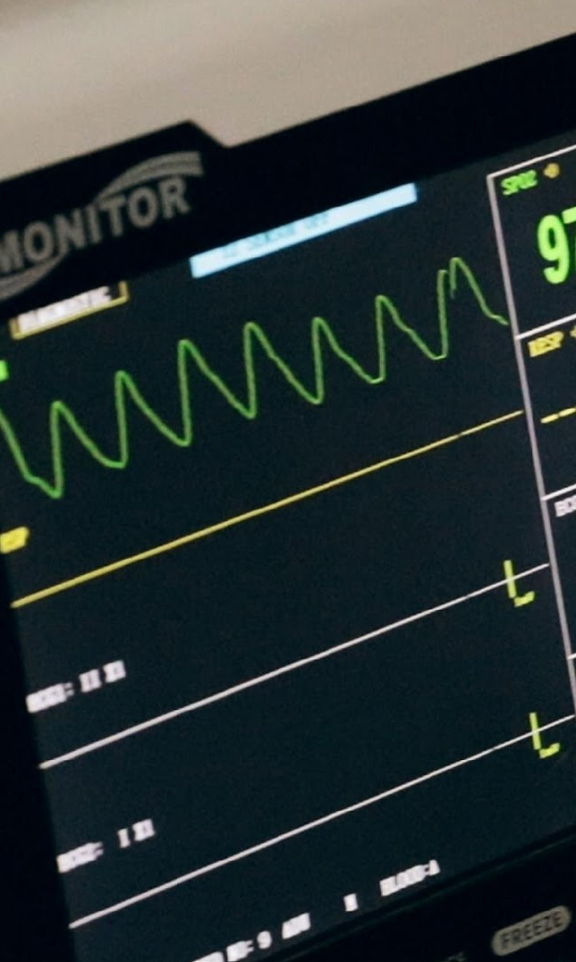
Predicting Stroke
Predictive Modeling
Summer 2019
Ananya
Andrew
Josh
Karen
Reid
Vinay

Slide 2

Agenda
Our problem / Review of dataset
Exploratory Analysis
Modeling
KNN
Logistic Regression
Tree Models
Boosting
Random Forest
Bagging
Model Comparisons

Slide 3
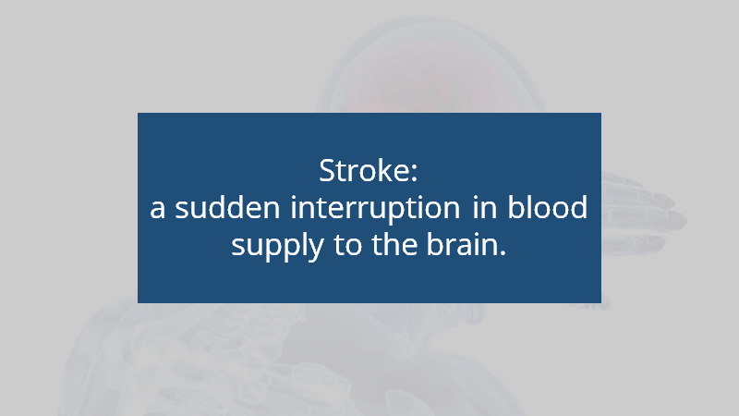

Slide 4
Introduction to our data
43,400 data points, representing patient data
12 variables
gender, age, hypertension, heart disease, marital status, work type, residence type, average glucose levels, body mass index, smoking status, and whether or not they are stroke victims
Data cleansing:
removed the 15 patients with missing gender data
removed patients under the age of 15

Slide 5
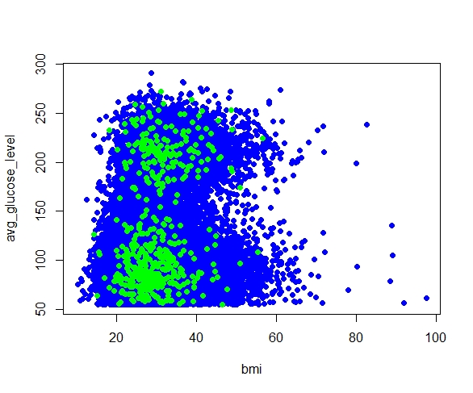
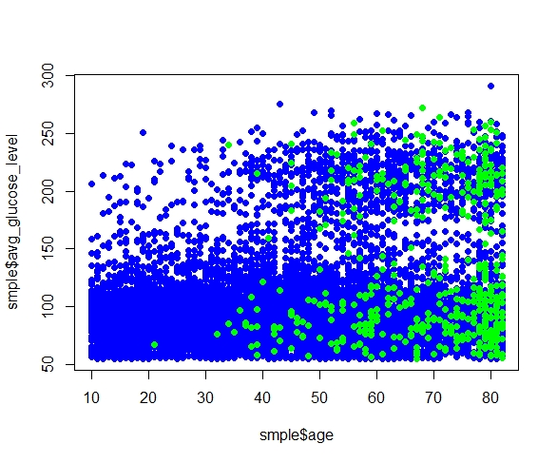
Exploratory Analysis
Strokes victims highlighted in green
We were hoping to see if the stroke victims were clumped together under certain statistics

Slide 6
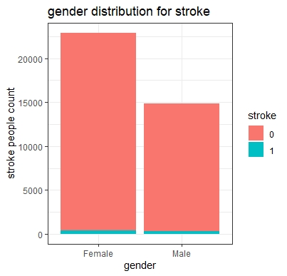
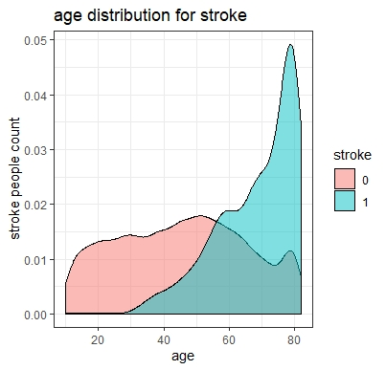
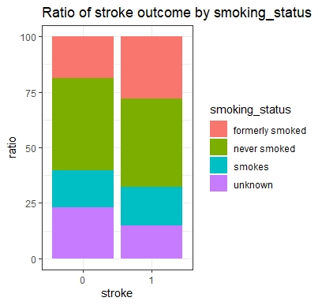
Exploratory Analysis

Slide 7

Using Accuracy as a performance metric
Classification problem: varying penalties
Skewed Data: accuracy already at 98%
Performance metrics:
Precision: fraction of relevant instances among the retrieved instances
Recall: fraction of the relevant instances successfully retrieved
Misclassification Rate: fraction of incorrectly labeled instances

Slide 8
KNN
Three models tried:
All features
Only age and gender
All medical features
All lifestyle features + age + gender
Validated by 10 - fold Cross-Validation
Best value of K for KNN: 300
Threshold set to 0.03
Confusion Matrix
Misclassification Rate: 0.112
Actual | Non-Stroke | Stroke
Non-Stroke | 3197 | 503
Stroke | 12 | 60
Predicted
Precision: 0.112
Recall: 0.883

Slide 9
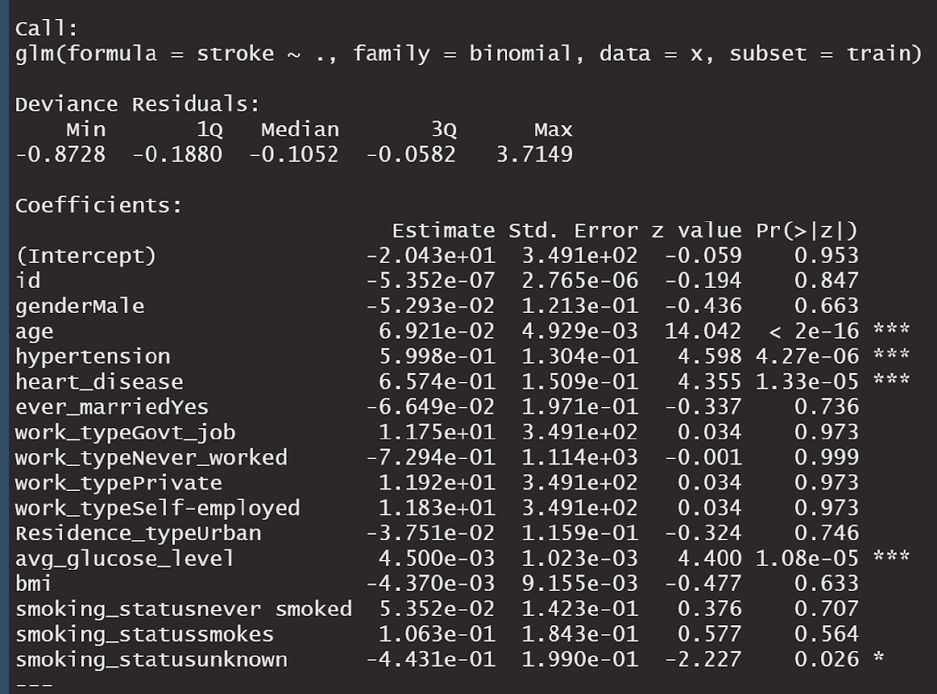
Logistic Regression Model
Imbalanced Data
1.7%
Threshold set at 0.03
Age
Hypertension
Heart Disease
Avg glucose level
Significant Predictors

Slide 10
Logistic Regression Model
Model Evaluated on test data
Misclassification Rate: 0.165
Confusion Matrix
Precision: 0.069
Actual | Non-Stroke | Stroke
Non-Stroke | 15478 | 2985
Stroke | 117 | 208
Predicted
Recall: 0.64

Slide 11
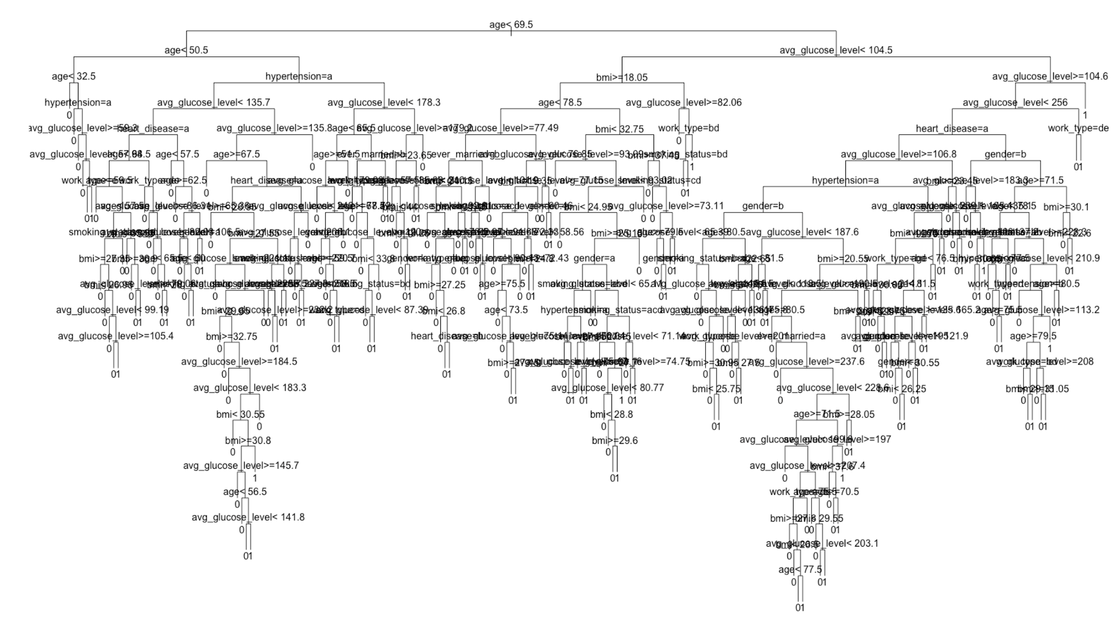
Classification - Tree Model
Resample: Unbalanced
Used resampling method to select train, validation and test data
Train accounts for a half of data and validation and test accounts for a quarter of data.
Confusion Matrix
Actual | Non-Stroke | Stroke
Non-Stroke | 9180 | 85
Stroke | 158 | 6
Predicted
Misclassification Rate: 0.036
Accuracy Rate: 0.974
Recall Rate: 0.034
Precision Rate: 0.06

Slide 12
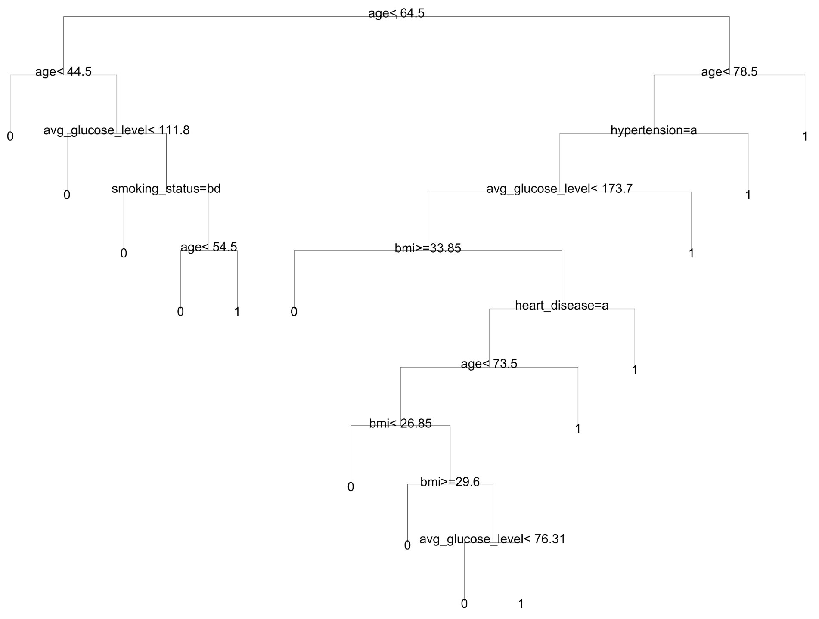
Classification - Tree Model
Construct balanced dataset
Selected 500 stroke records and 1000 non-stroke records as the train dataset
Divided the rest of data equally into validation and test
Confusion Matrix
Actual | Non-Stroke | Stroke
Non-Stroke | 14443 | 3591
Stroke | 25 | 50
Predicted
Misclassification Rate: 0.20
Accuracy Rate: 0.80
Recall Rate: 0.67
Precision Rate: 0.014

Slide 13
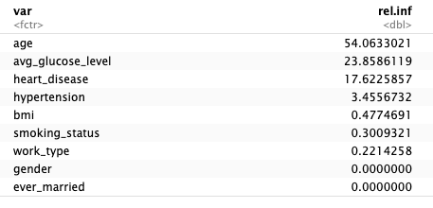
Boosting
Confusion Matrix
 | Non-Stroke | Stroke
Non-Stroke | 16319 | 2223
Stroke | 162 | 155
Predicted
Actual
Misclassification Rate: 0.13
Precision: 0.065
Recall: 0.490
Notes:
these features correspod to previous models. Although mis improved, can at expense with precision and recall.

Slide 14
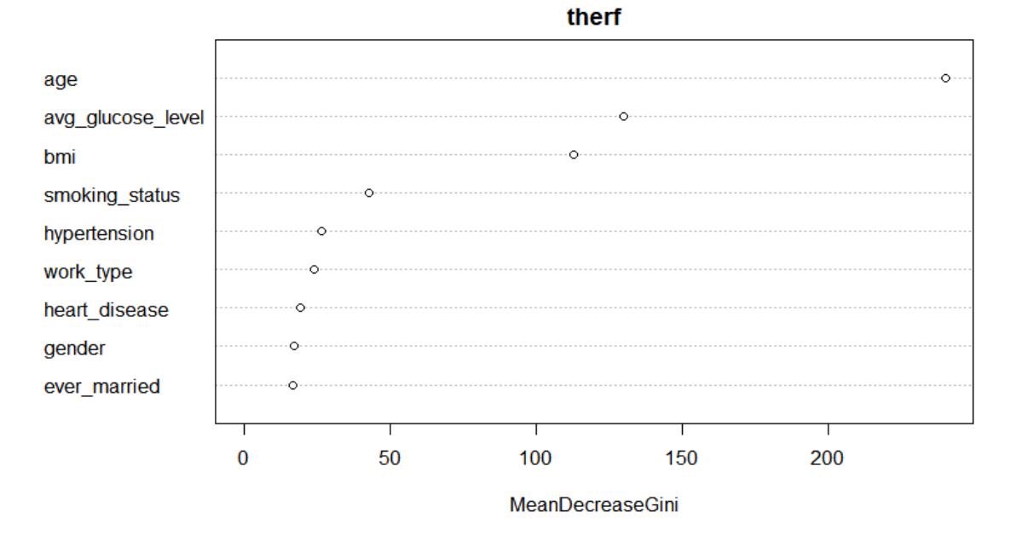
Random Forest
Confusion Matrix
Actual | Non-Stroke | Stroke
Non-Stroke | 15804 | 2956
Stroke | 31 | 38
Misclassification Rate=0.15
Precision= 0.012
Recall= 0.55

Slide 15
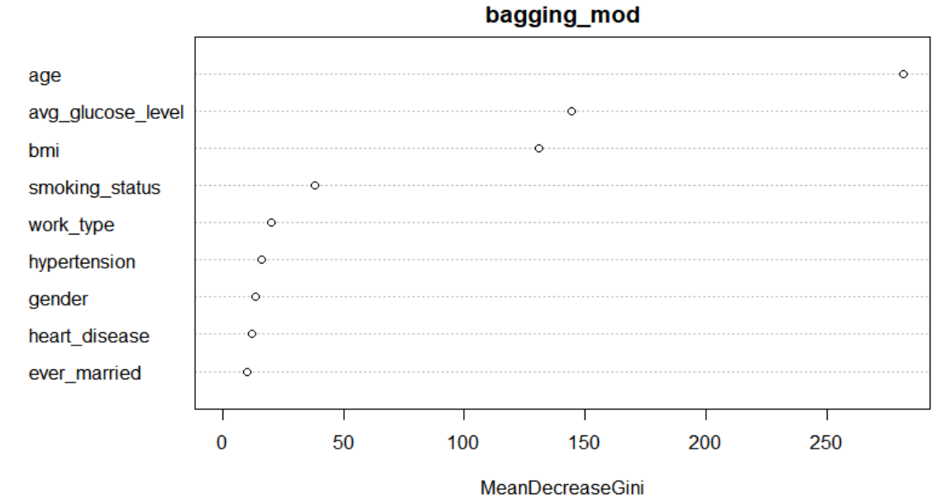
Bagging
Confusion Matrix
Actual | Non-Stroke | Stroke
Non-Stroke | 14865 | 3175
Stroke | 29 | 40
Misclassification Rate=0.18
Precision= 0.012
Recall= 0.58

Slide 16
Model Comparison
Logistic Regression
Random Forest
KNN
Tree
Boosting
Misclassification Rate: 0.112
Misclassification Rate: 0.165
Misclassification Rate: 0.20
Misclassification Rate: 0.13
Misclassification Rate: 0.15
Precision: 0.112
Precision: 0.069
Precision: 0.014
Precision: 0.065
Precision: 0.012
Recall: 0.883
Recall: 0.064
Recall: 0.67
Recall: 0.49
Recall: 0.55
Bagging
Misclassification Rate: 0.18
Precision: 0.012
Recall: 0.58

Slide 17
Questions?

